Slide 1

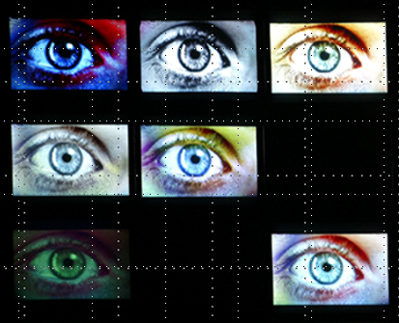
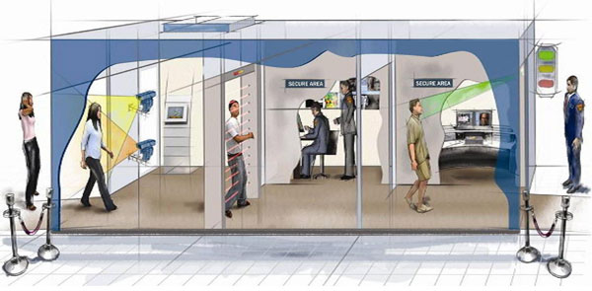
Cases of POOC to detect the highly dangerous person and
possible criminal by CCTV connected to VIBRASYSTEM
VIBRASYSTEM

Slide 2

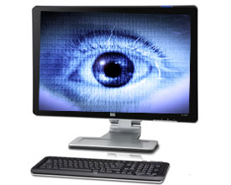

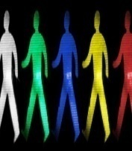

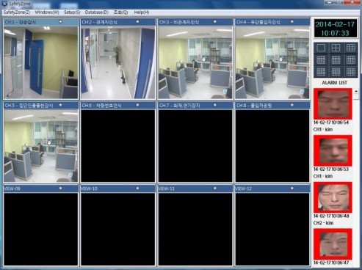
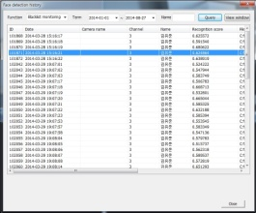

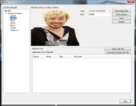
Detecting and Tracking system for potential terrorist
□ Basic System Structure
Detect
Detect
Event for detecting suspect person
(CCTV video information,
Face image)
Event history
Event history
Detection Server
Registration
Tracking
server
 | Detection Server | Tracking Server
Main Function | - To detect dangerous person in AlphaEye system - Acquire Face image of dangerous person - To transfer Suspect person’s information to Tracking server - To manage event history | - To track dangerous person detected by Detection system 위험의심 - To track Black list and defined person in advance - To manage event history
CCTV Chanel | 1 chanel (1 PC Analyzer + 1 CCTV | - Basically 10 CCTV by one monitoring system
OS/DB | Windows / MySQL

Slide 3

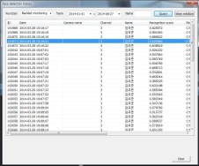

Detecting and Tracking system for potential terrorist
Detection Analyzer
Detect the dangerous
person and, order action
① Capture video and analyze
Suspect level by CCTV
② Detect Suspect level and capture
video image
Event history management
Detecting server
③ Track captured suspect person
(Face recognition)
Tracking server
To track Black Listed person
(Linked to Police station)
Detection
BL
Event history management
⑥ Finish tracking after
some working time
and event completion
④ Track the highly dangerous person
captured by Detection function
(Face recognition->Tracking)
⑤ Event history management

Slide 4
Product types
Product | Features | Main Functions
AlphaEye | 1) Suspect detection | Potentially suspect person out of crowd
2. AlphaEye Plus | 1) Suspect detection 2) Face recognition to clarify BL | Potentially suspect person out of crowd Transfer the event information to VMS Clarify BL by Face recognition
3. AlphaEye Pro | 1) Suspect detection 2) Face recognition to clarify BL 3) Suspect tracking | Potentially suspect person out of crowd Transfer the event information to VMS Clarify BL by Face recognition Track suspect automatically

Slide 5
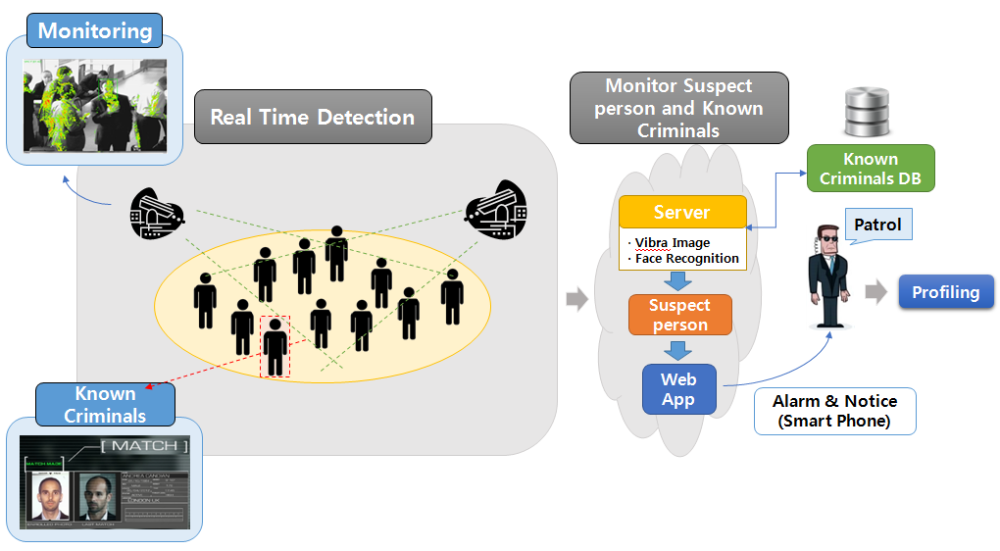
Two functions : Monitoring and Matching
To detect dangerous person
Face Recognition
(Matched to black list)
(Suspect information is transferred
to smart phone?

Slide 6
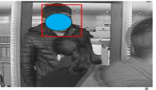
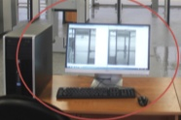

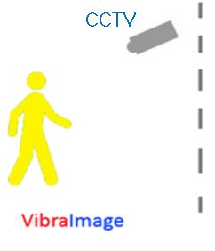

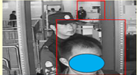
Profiling process to detect to potential terrorist
1st Stage
Profiler
Pass !
Dangerous person !
Suspect !
AlphaEye system
Screen for detailed investigation

Slide 7
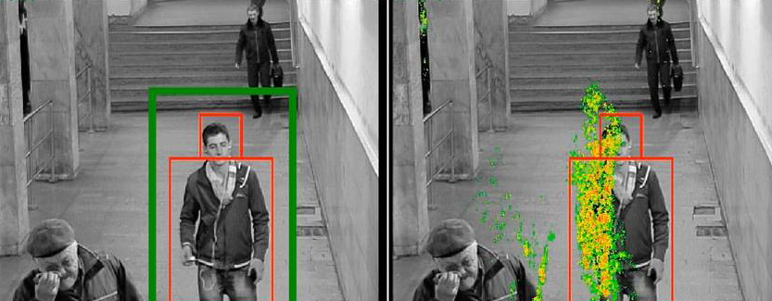
Example of High Suspect person
Check box color will be changed to Red color if he is captured
by suspect level setting.
Suspect level

Slide 8
System type
  Individual system
  - Will be controlled by one individual system
  Centered monitoring system
  - Will be controlled and managed by Multi CCTVs
  to the corresponding Detection Analyzers

Slide 9


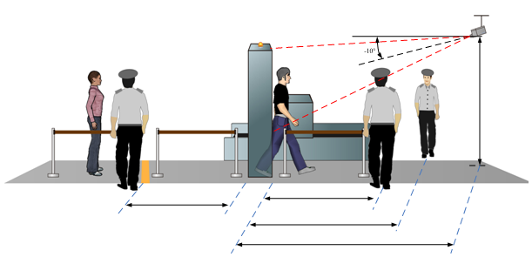
System components and CCTV installation guide
“AlphaEye” system
: 1 PC + 1 CCTV
PC1
CCTV installation guide
CCTV installation guide：
Passenger Pathway or Checking station
Distance : Typically 5-6m or longer
Need to focus
Illumination : 200-1000lux
Camera height : 2 - 2.5m
Camera angle : 10-20 degree

Slide 10
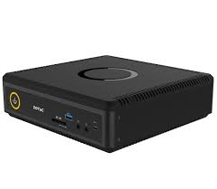


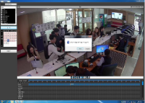
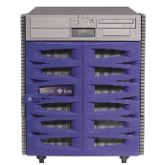
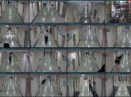
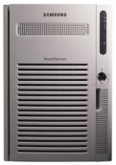


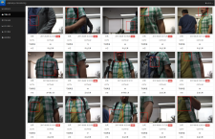




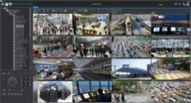
Suspect Detecting and Tracking
(Central Control system))
AlphaEye Pro (Detecting + Tracking function) system structure
Detection server
Tracking server
Video Anlyzer-01
CCTV-01
Video Anlyzer-02
CCTV-02
Internet
Router
Video Anlyzer-03
CCTV-03
Fire wall
Video Anlyzer-04
CCTV-04
Smart Phone
Integrated Monitoring
System
Face Recognition
System
Video Anlyzer-NN
CCTV-NN
VMS
(Video Management System)

Slide 11



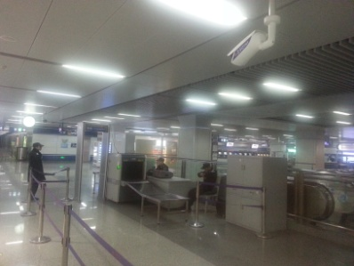
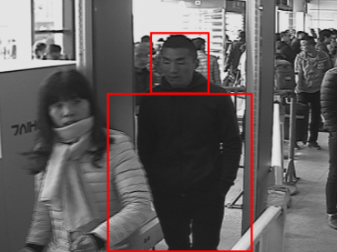
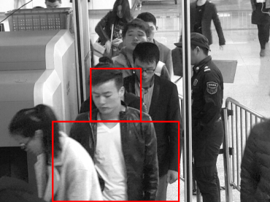
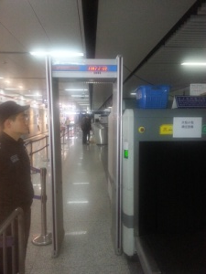
1) Metal Detector pathway by Dynamic mode
Entrance
X-ray
Metal Detector
Video Analyzer
CCTV
CCTV
Sample pictures
* Metal Detector pathway

Slide 12
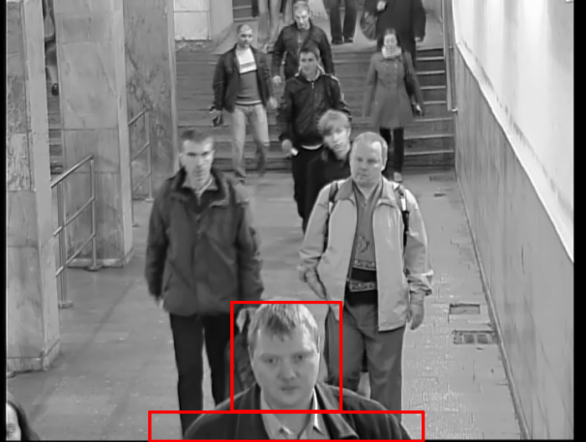
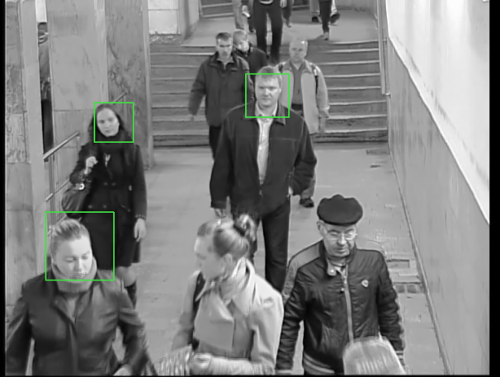
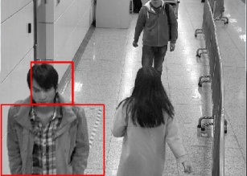
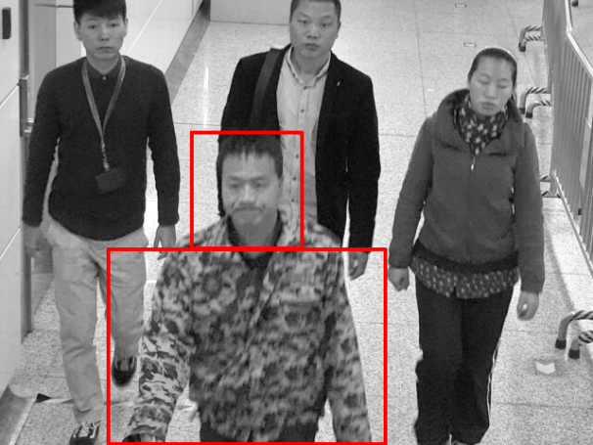
2) Passenger’s pathway by Dynamic mode
Sample pictures
* Passenger’s moving pathway or area
Entrance
AlphaEye
Suspect
Level
CCTV
Exit

Slide 13
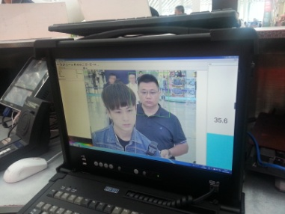
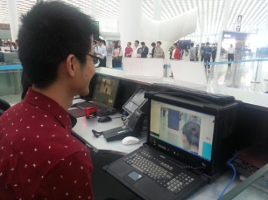
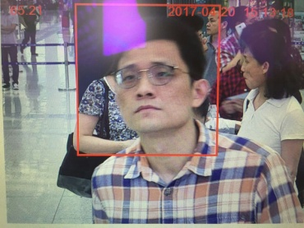
3) Passport check station by Static mode
Entrance
Camera
AlphaEye
Inspector
Suspect
level
Sample pictures
Passport or ID inspection
Station

Slide 14
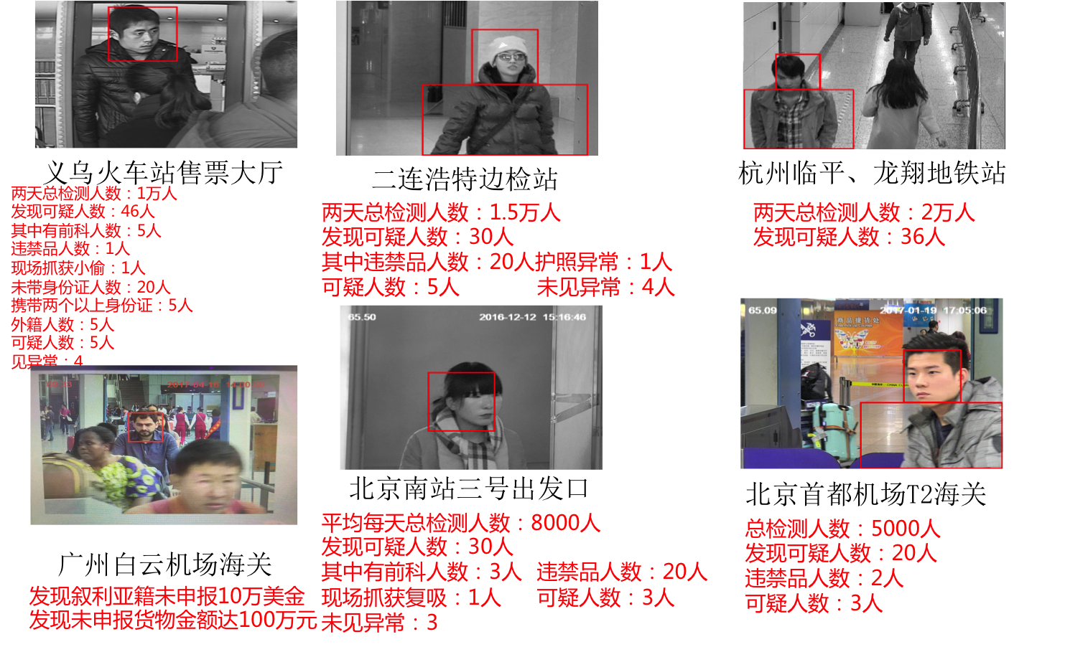
Testing Report Samples
Iyoo station
-Total persons:10K
-Suspect:46
-Ex-convict:5
-Prohibited goods:1
-Robber captured at on-site:1
-No ID holder:20
-Many ID holder:5
-Forigner:5
-Suspect:5
Inner Mongolia border
-total:15K
-Suspect:30
-Prohibited goods:20
-Passport issue:1
-No ID holder:20
-Many ID holder:5
-Foreigner:5
-Supsect:5
Hanzhou subway station
-Total:20K
-Suspect:36
Beijing airport
-Total:5K
-Suspect:20
-Prohibited:2
-Suspect:5
Beijing High speed station
-Total:8K
-Suspect:30
-Ex-convict:5
-Prohibited goods:20
-Drugger:1(female)
-Suspect:3
-Normal:3
Guangzhou airport
Detect cash carrier without
any declaring to customs
-Immediately arrested by
police and investigated..

Slide 15
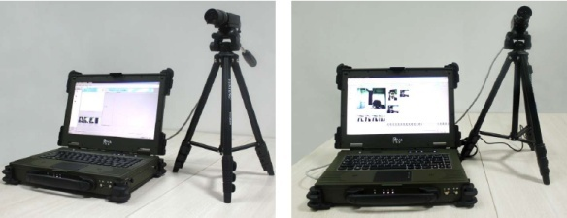
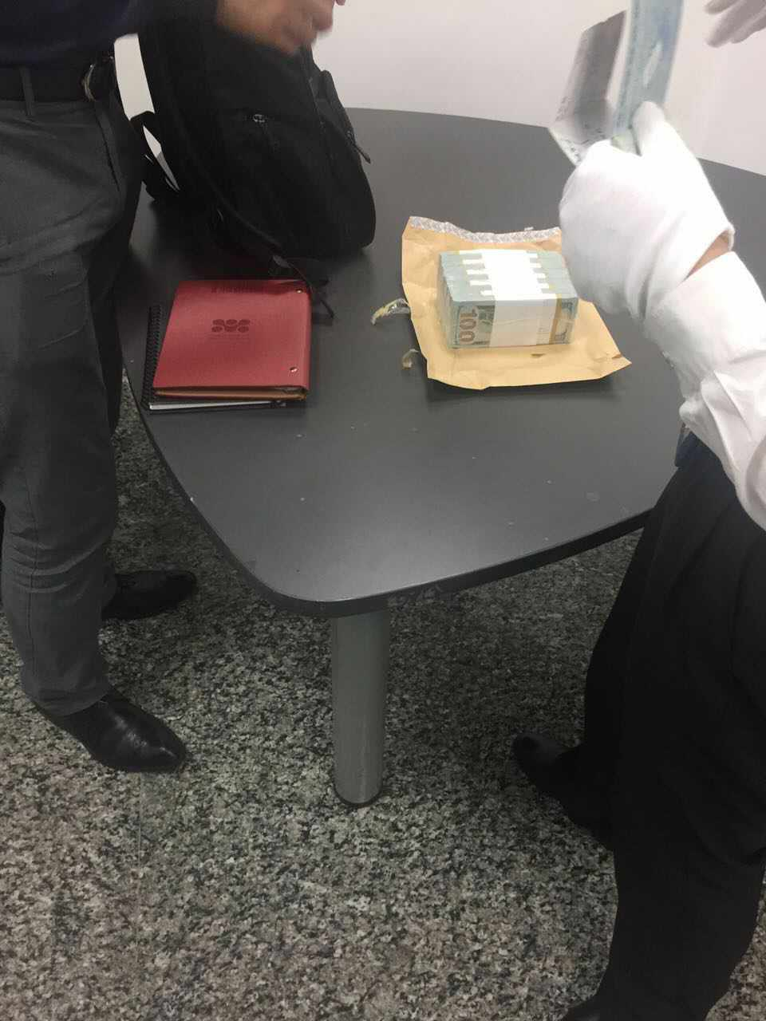
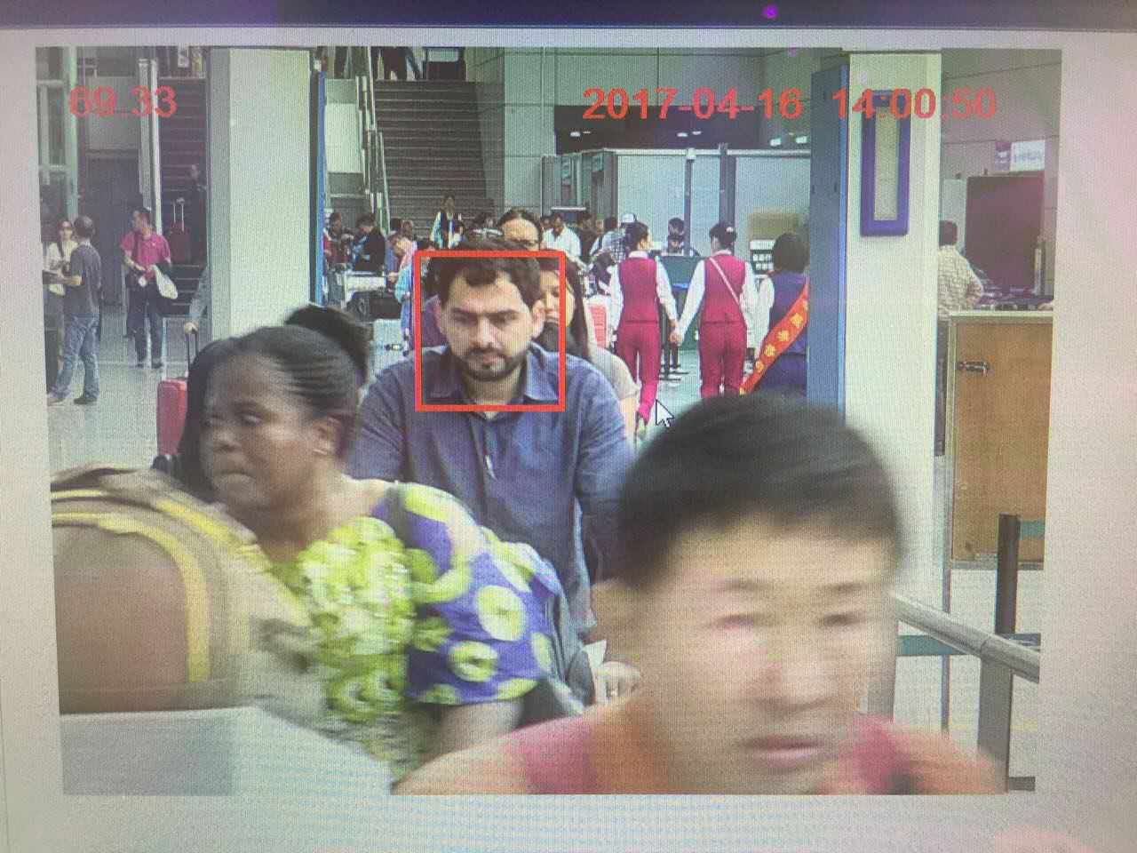
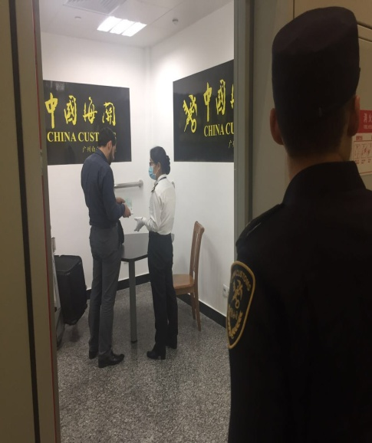
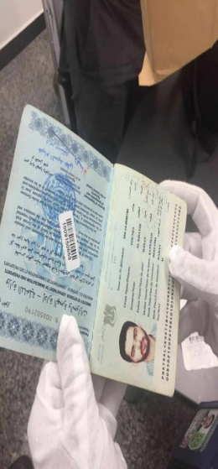
Evidence of remarkable event to detect suspect
Example at Guangzhou airport
AlphaEye system
Captured and detected to hide and
carry US$100,000 illegally
in baggage
Investigation
Detected US$100K
PASSPORT CHECK
SUSPECT LEVEL
: 69.3
Investigation location

Slide 16
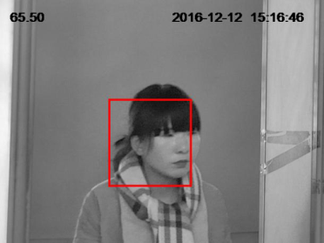
Evidence of remarkable event to detect suspect
Example at Beijing South station
AlphaEye system
Captured and detected by drug injection
After inspecting very seriously,
she was immediately arrested.
SUSPECT LEVEL
: 65.5

Slide 17
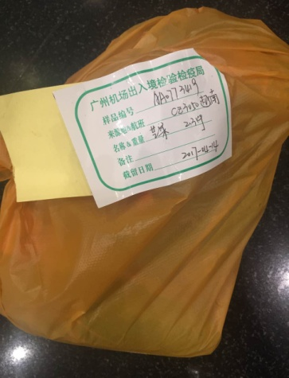
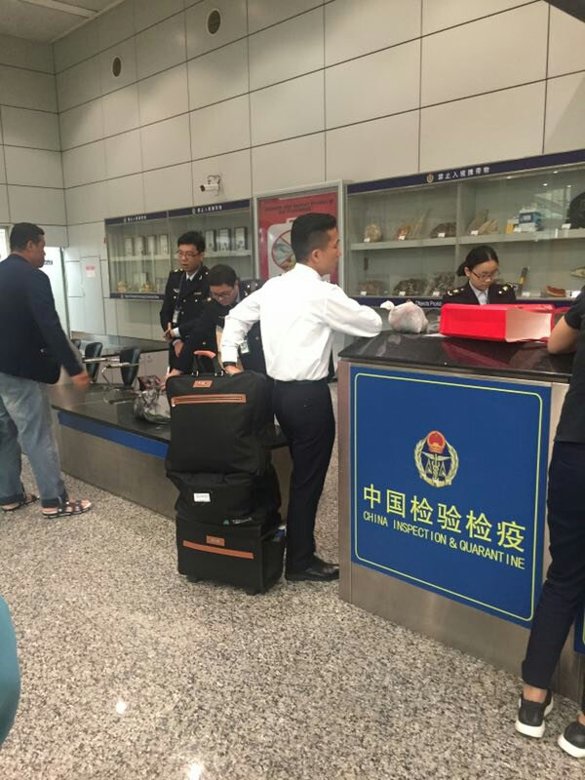
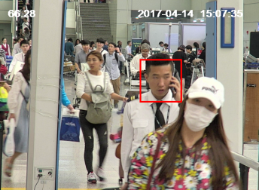
Evidence of remarkable event to detect suspect
Example at Guangzhou airport
AlphaEye system
Captured and detected to hide and
carry illegally many kinds of fruits
Many kinds of fruits
Crew
SUSPECT LEVEL
: 66
Investigation location

Slide 18
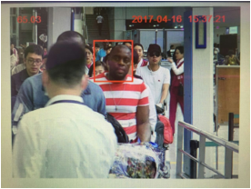
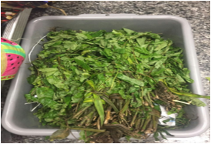
Evidence of remarkable event to detect suspect
Example at Guangzhou airport
AlphaEye system
Captured and detected to hide and carry illegally
a specific plant with drug ingredient in baggage
Prohibited items for
national importation
Investigation location
SUSPECT LEVEL
: 65

Slide 19
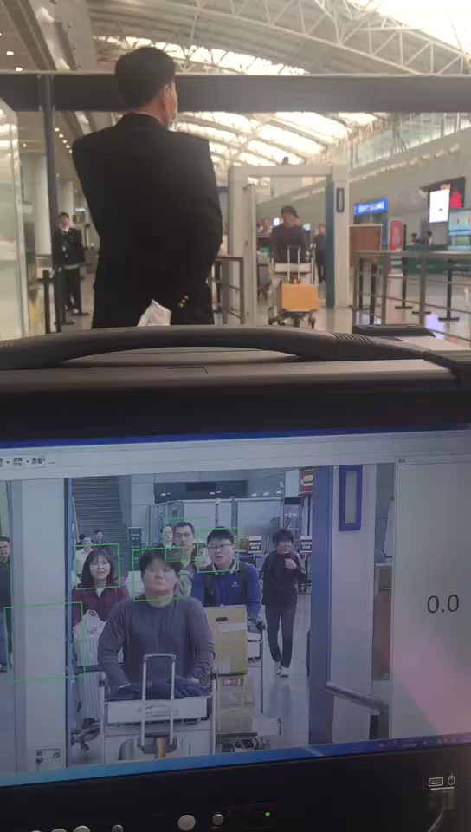

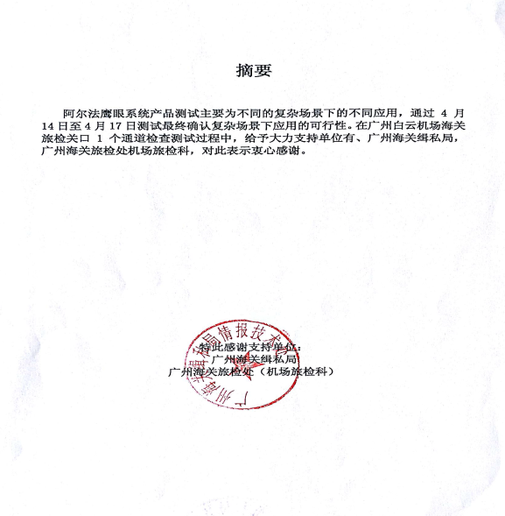
Testing Report sample
Testing report at Guangzhou airport

Slide 20

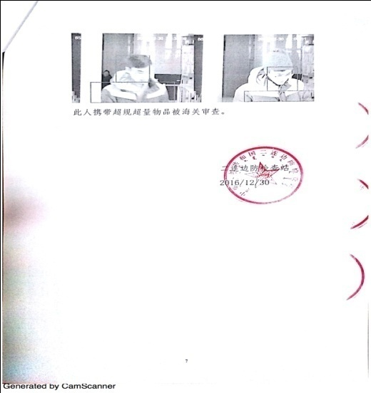
Testing Report sample
Testing report at Erlanhoutu border

Slide 21

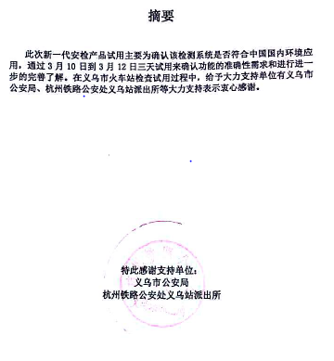

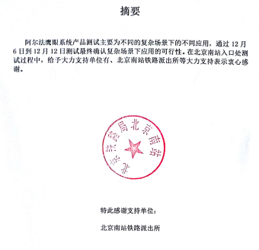




Testing Reports in China

Slide 22


Testing Report sample
Testing in Philippines
Testing in Malaysia
Manilar International Airport Immigration
Horbour City Port Klang Customs
Kuah Jetty Langkawi Customs

Slide 23



Certification and Copy right
Patent FOR VI algorithm in Korea
(Co-applicant with ELSYS)
China Certification
as “ALPHAEYE” product name (By China Police Lab.)
Gold medal award
in 2017 China International Big Data Competition

Slide 24




Comparison of Profiling method
Naked eye profiling
Detecting by human naked eye
Subjective judgment
High operation cost
American method(SPOT)
As is
Profiler’s
Function
Advanced profiling method
Technical Profiling
Detecting by Psycho-physiological
parameters by CCTV’s video image
Objective judgment
Low operation cost
VIBRASYSTEM
To be
VIBRA
SYSTEM
The profiling method will be changed in a near future from American’s SPOT method to VIBRASYSTEM’s technical profiling method, which requires the low operation cost and provides the objective judgment.
Reference :
United States Government Accountability Office, AVIATION SECURITY: TSA Should Limit Future Funding for Behavior Detection Activities, GAO-14-159, November 2013.

Slide 25
Monitoring System Introduction

Slide 26


Monitoring system
Controlled and managed at hub center
Monitoring
Specific CCTV/Analysis system
Monitoring system
Video analyzer
CCTV #1
Monitoring


1. Real time monitoring
2. A certain specific CCTV
monitoring
3. All CCTV monitoring
Video analyzer
CCTV #6
Intranet
Data acquisition system
Video analyzer
CCTV #7


1. Data reception
2. Data storage
Video analyzer
CCTV #12

Slide 27



Monitoring System
AlphaEye Monitoring
Log in
CCTV monitoring
AlphaEye
Suspect monitoring
View history
View statistics
Date
CCTV
Time
아이디
Log in
패스워드
User information
CCTV information

Slide 28






Monitoring System
Example of Suspect Monitoring
AlphaEye : T2
Login
CCTV monitoring
Picture | Date | 2017/8/8 12:25:54
 | CCTV | 1
 | Suspect | 70
 | State | On going
Picture | Date | 2016/8/8 12:25:54
 | CCTV | 2
 | Suspect | 61
 | State | On going
Suspect monitoring
View history
View statistics
Date
CCTV
Time
Picture | Date | 2016/8/8 12:25:54
 | CCTV | 3
 | Suspect | 69
 | State | On going
Picture | Date | 2016/8/8 12:25:54
 | CCTV | 4
 | Suspect | 66
 | State | On going
User information
CCTV information
Picture | Date | 2016/8/8 12:25:54
 | CCTV | 5
 | Suspect | 67
 | State | On going
Picture | Date | 2016/8/8 12:25:54
 | CCTV | 6
 | Suspect | 69
 | State | On going

Slide 29
Service example of Monitoring System
CCTV State Monitoring information
AlphaEye Monitoring : T2
Log in
CCTV Monitoring
Time : 2017/01/12 14:23:23
Suspect Monitoring
일 시 | CCTV NO | ON/OFF | 일 시 | CCTV NO | ON/OFF
2016/8/8 12:23:54 | 1 |  | 2016/8/8 12:23:54 | 2
2016/8/8 11:34:33 | 3 |  | 2016/8/8 11:34:33 | 4
2016/8/8 10:45:21 | 5 |  | 2016/8/8 10:45:21 | 6
2016/8/8 12:23:54 | 7 |  | 2016/8/8 12:23:54 | 8
2016/8/8 11:34:33 | 9 |  | 2016/8/8 11:34:33 | 10
2016/8/8 12:23:54 | 11 |  | 2016/8/8 12:23:54 | 12
Event History
Statistics
Date
CCTV
Time
User Information
CCTV Information
< 1 2 3 4 5 6 7 8 9 10 >

Slide 30

Service example of Monitoring System
Monitoring information
Picture | Date | 2016/8/8 12:23:54
 | CCTV | 1
 | Suspect | 70
 | State
On going
Finished
No suspect
change
Close

Slide 31
Service example of Monitoring System
CCTV State Monitoring information
AlphaEye Monitoring : T2-C1
Log in
Last 1 week
Last 1 month
CCTV Monitoring
Suspect Monitoring
Last 1 week
Event History
Statistics
Date
CCTV
Time
User Information
CCTV Information

Slide 32
Service example of Monitoring System
Monitoring of Detection Information
When clicking the captured picture, the detailed information will pop-up on screen.
Event Status
Picture | Time | 2016/8/8 12:23:54
 | CCTV | 1
 | Suspect Level | 70
 | Status
Processing
Finished
N/A
Change
Exit

Slide 33

Service example of Monitoring System
Track Suspect person and monitor event history

Slide 34





Service Example of Monitoring system by Smart phone
Detection information will be transferred by smart phone
Log in
AlphaEye Monitoring
Internet
ID
AlphaEye Monitoring
PASSWD
Login
Suspect Information
Suspect DB
Time | 2017-09-15 12:33:21
CCTV | CCTV-25
Suspect | 46
DB/WEB Server

